Slide 1
Frequency Analysis of Monoalphabetic Ciphers Example
INSERT
VIDEO
HERE

Slide 2
Frequency Analysis of Monoalphabetic Ciphers Example
Ciphertext key randomly generated
INSERT
VIDEO
HERE

Slide 3
Frequency Analysis of Monoalphabetic Ciphers Example
Ciphertext key randomly generated
Plaintext
INSERT
VIDEO
HERE

Slide 4
Frequency Analysis of Monoalphabetic Ciphers Example
Ciphertext key randomly generated
Plaintext
Author: Leo Tolstoy
INSERT
VIDEO
HERE

Slide 5
Frequency Analysis of Monoalphabetic Ciphers Example
Ciphertext key randomly generated
Plaintext
Author: Leo Tolstoy
Source: 1 of 7 novels
INSERT
VIDEO
HERE

Slide 6
Frequency Analysis of Monoalphabetic Ciphers Example
Ciphertext key randomly generated
Plaintext
Author: Leo Tolstoy
Source: 1 of 7 novels
Test: 250 characters from middle half
INSERT
VIDEO
HERE

Slide 7
Leo Tolstoy ciphertext
WEDIO CDWZH IJUPK EPUOI VODPO
DIEWE KCOZI EEJIW KSLHW KIHHP
UUPWV HSLOC KYIOD IYCLK OIHHY
PJJIE DIVHC KPKEW KUCVZ IEDWZ
ODPOH DIDPE PQVCZ WHHCV FKCOI
UVCZP KKPZW NDPFJ CTKPU CVOGC
ODCLH PKEVL SJIHP KEPHN IEDWZ
GDPOD IODCL XDOCU ECWKX GWODW
OODWH PKHGI VIEKW YDCJP HFCLH
PFWOV IHOHG WODZI GIJJW ECKOJ
INSERT
VIDEO
HERE

Slide 8
Single- and double-letter frequencies for the Leo Tolstoy ciphertext yields some clues, but not a lot
C single double | C single double | C single double
----------------+-----------------+----------------
I 9.200 0.000 | V 4.400 0.000 | N 0.800 0.000
O 9.200 11.111 | J 4.000 22.222 | X 0.800 0.000
D 8.400 0.000 | Z 3.600 0.000 | Q 0.400 0.000
P 8.400 0.000 | U 3.200 11.111 | T 0.400 0.000
C 8.000 0.000 | L 2.800 0.000 | A 0.000 0.000
H 8.000 33.333 | G 2.400 0.000 | B 0.000 0.000
K 7.600 11.111 | F 1.600 0.000 | M 0.000 0.000
W 7.600 0.000 | Y 1.600 0.000 | R 0.000 0.000
E 6.400 11.111 | S 1.200 0.000
INSERT
VIDEO
HERE

Slide 9
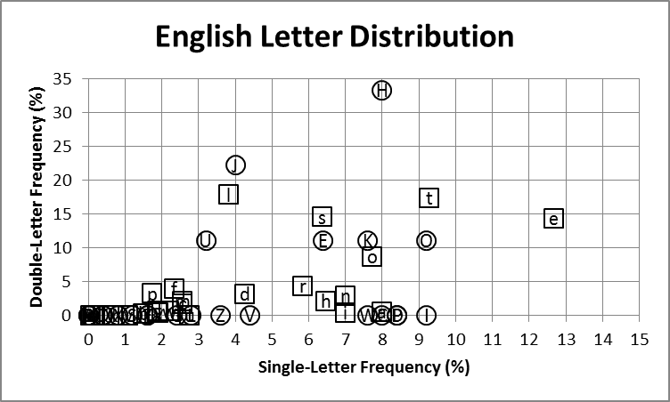
Plot of double vs. single character frequencies highlights the confusion
INSERT
VIDEO
HERE

Slide 10
Obvious mappings may be misleading due to outliers
INSERT
VIDEO
HERE

Slide 11
Increasing the ciphertext from 250 characters to 2500 characters makes a profound difference
INSERT
VIDEO
HERE

Slide 12
Increasing the ciphertext from 250 characters to 2500 characters makes a profound difference
C single double | C single double | C single double
----------------+-----------------+----------------
I 12.449 12.768 | E 4.683 3.611 | Q 1.780 3.068
O 8.928 16.430 | J 3.819 15.552 | S 1.381 0.274
P 8.130 0.725 | L 2.582 0.043 | T 1.065 0.009
C 7.615 9.412 | Z 2.437 1.900 | N 0.821 0.014
K 7.283 2.879 | Y 2.427 1.244 | A 0.160 0.091
W 6.866 0.411 | G 2.344 0.932 | B 0.099 0.000
D 6.636 2.426 | U 2.167 3.810 | R 0.095 0.054
H 6.448 16.733 | X 2.025 0.792 | M 0.092 0.000
V 5.842 6.442 | F 1.827 0.380 |
INSERT
VIDEO
HERE

Slide 13
single vs. double letter frequencies for 2500 ciphertext characters shows clear pairings
INSERT
VIDEO
HERE

Slide 14
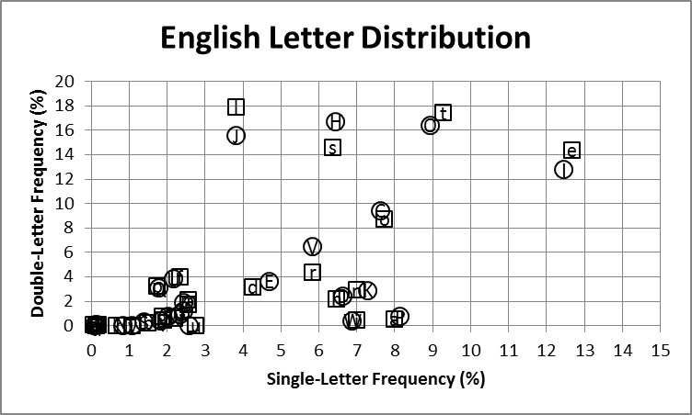
single vs. double letter frequencies for 2500 ciphertext characters shows clear pairings
INSERT
VIDEO
HERE

Slide 15
CIPHERTEXT: ABCDEFGHIJKLMNOPQRSTUVWXYZ PLAINTEXT : o d sel t r
INSERT
VIDEO
HERE

Slide 16
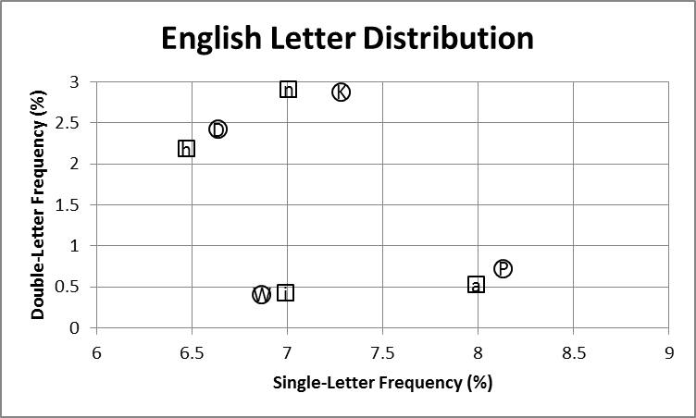
CIPHERTEXT: ABCDEFGHIJKLMNOPQRSTUVWXYZ PLAINTEXT : ohd seln ta ri
INSERT
VIDEO
HERE

Slide 17
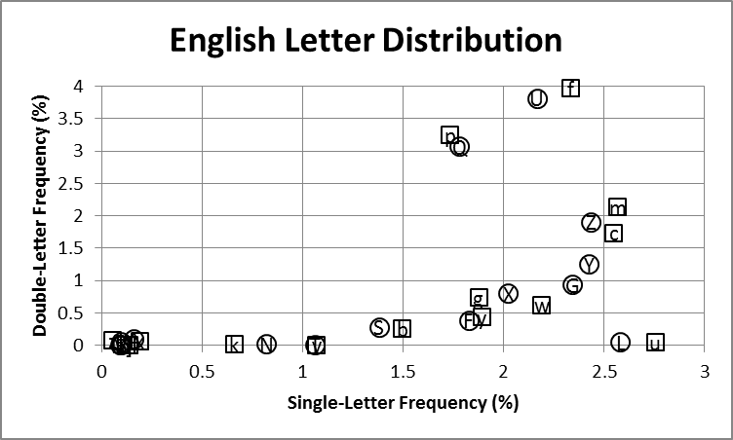
CIPHERTEXT: ABCDEFGHIJKLMNOPQRSTUVWXYZ PLAINTEXT : ohd selnu ktap bvfri
INSERT
VIDEO
HERE

Slide 18
CIPHERTEXT: ABCDEFGHIJKLMNOPQRSTUVWXYZ PLAINTEXT : ohd selnu ktap bvfri
INSERT
VIDEO
HERE

Slide 19
CIPHERTEXT: ABCDEFGHIJKLMNOPQRSTUVWXYZ PLAINTEXT : ohdywselnu ktap bvfrigcm
INSERT
VIDEO
HERE

Slide 20
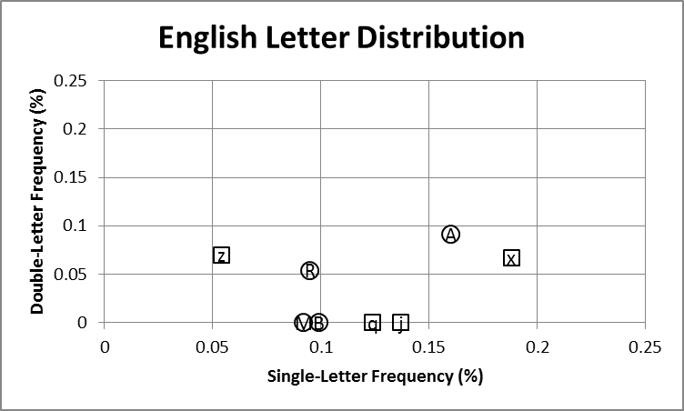
CIPHERTEXT: ABCDEFGHIJKLMNOPQRSTUVWXYZ PLAINTEXT : x ohdywselnu ktapzbvfrigcm
INSERT
VIDEO
HERE

Slide 21
CIPHERTEXT: ABCDEFGHIJKLMNOPQRSTUVWXYZ PLAINTEXT : xjohdywselnuqktapzbvfrigcm
INSERT
VIDEO
HERE

Slide 22
Frequency analysis on 2500 characters of ciphtertext produced correct cipher map
INSERT
VIDEO
HERE

Slide 23
Frequency analysis on 2500 characters of ciphtertext produced correct cipher map
C: ABCDEFGHIJKLMNOPQRSTUVWXYZ
INSERT
VIDEO
HERE

Slide 24
Frequency analysis on 2500 characters of ciphtertext produced correct cipher map
C: ABCDEFGHIJKLMNOPQRSTUVWXYZ A: xjohdywselnuqktapzbvfrigcm
INSERT
VIDEO
HERE

Slide 25
Frequency analysis on 2500 characters of ciphtertext produced correct cipher map
C: ABCDEFGHIJKLMNOPQRSTUVWXYZ A: xjohdywselnuqktapzbvfrigcm
P: xjohdywselnuqktapzbvfrigcm
INSERT
VIDEO
HERE

